Slide 1
Simple class exercises
Object oriented programming

Slide 2
0.DynamicArray

Slide 3
Requirement
Create a dynamic integer array with 5 integers from keyboard
Print out the sum of all the integers
Implement the dynamic array using

Slide 4
Class diagram - Analysis

Slide 5
Class diagram - Design

Slide 6
Sample

Slide 7
1.Random

Slide 8
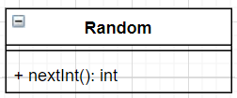
Class diagram – Analysis

Slide 9
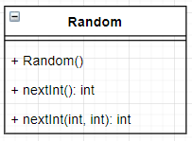
Class diagram - Design
We know that in order to generate a random number, we must initialize the generator with a seeder
That’s why we add constructor
We need to generate integer in some certain range, so we add new method nextInt(int, int): int

Slide 10
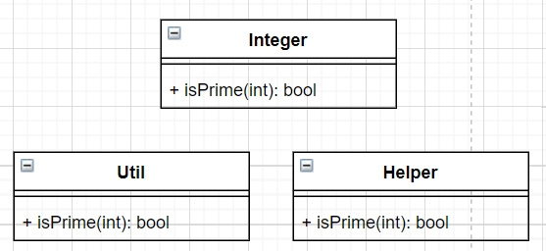
Some things to consider
Where to put function “bool isPrime(int)”?
Maybe we can put it in Util / Helper class
This function is related to integer number so may be we can create a class Integer and put it there

Slide 11
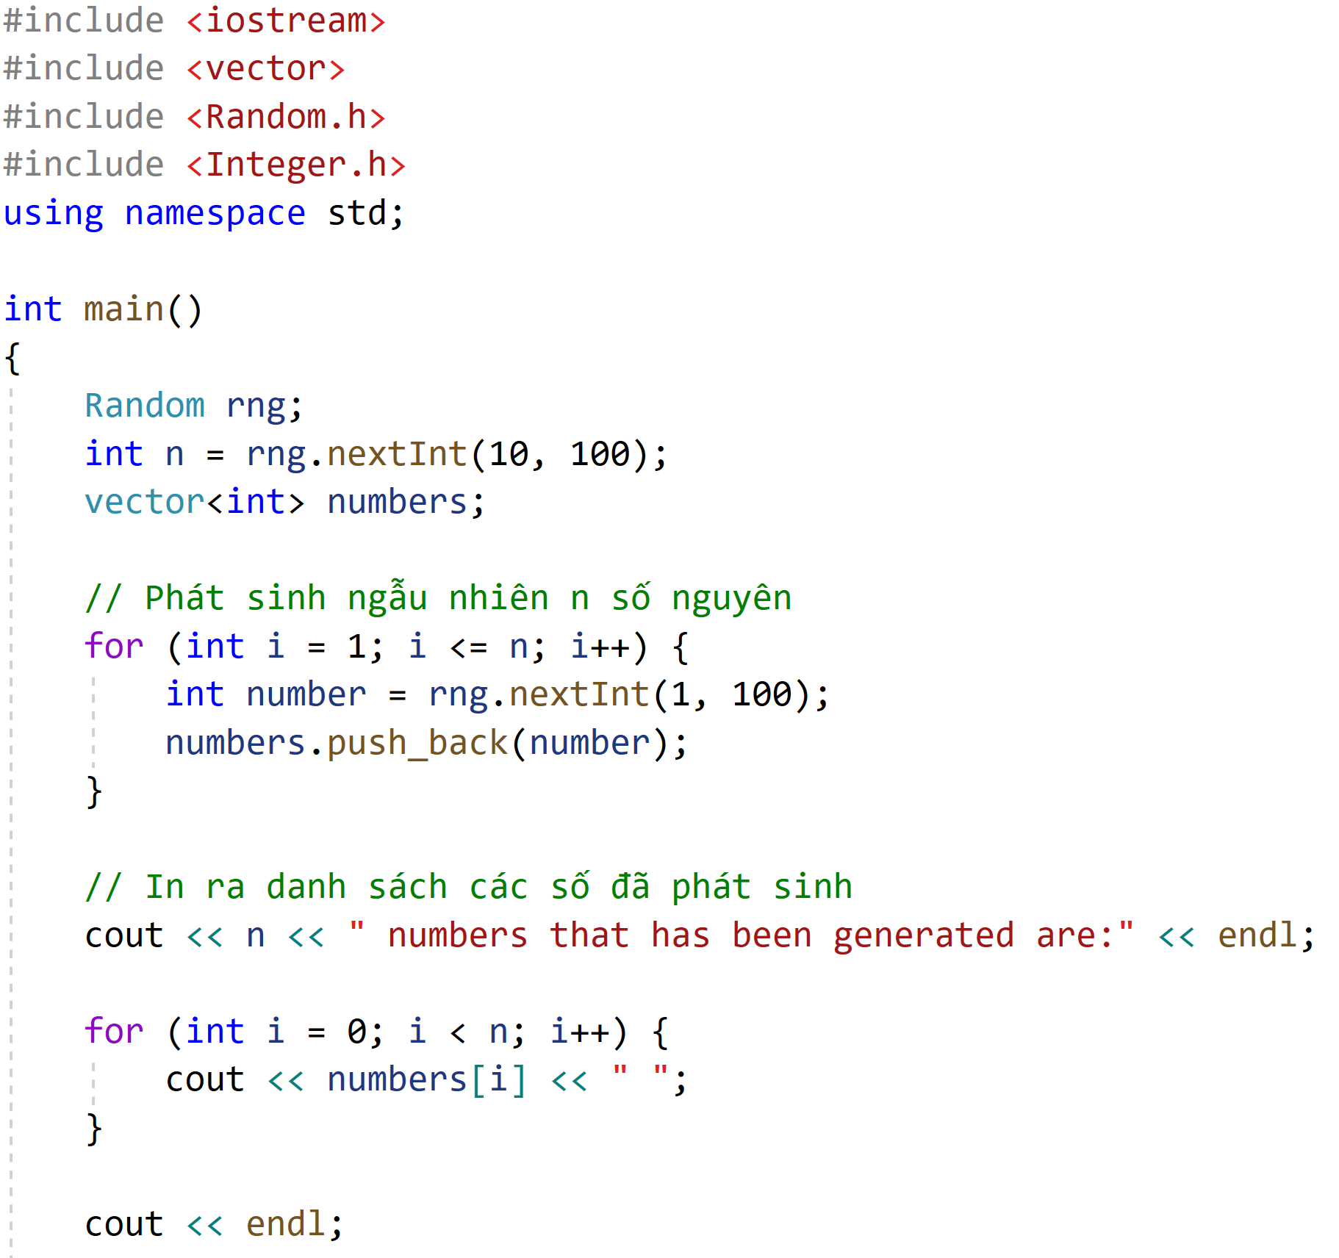
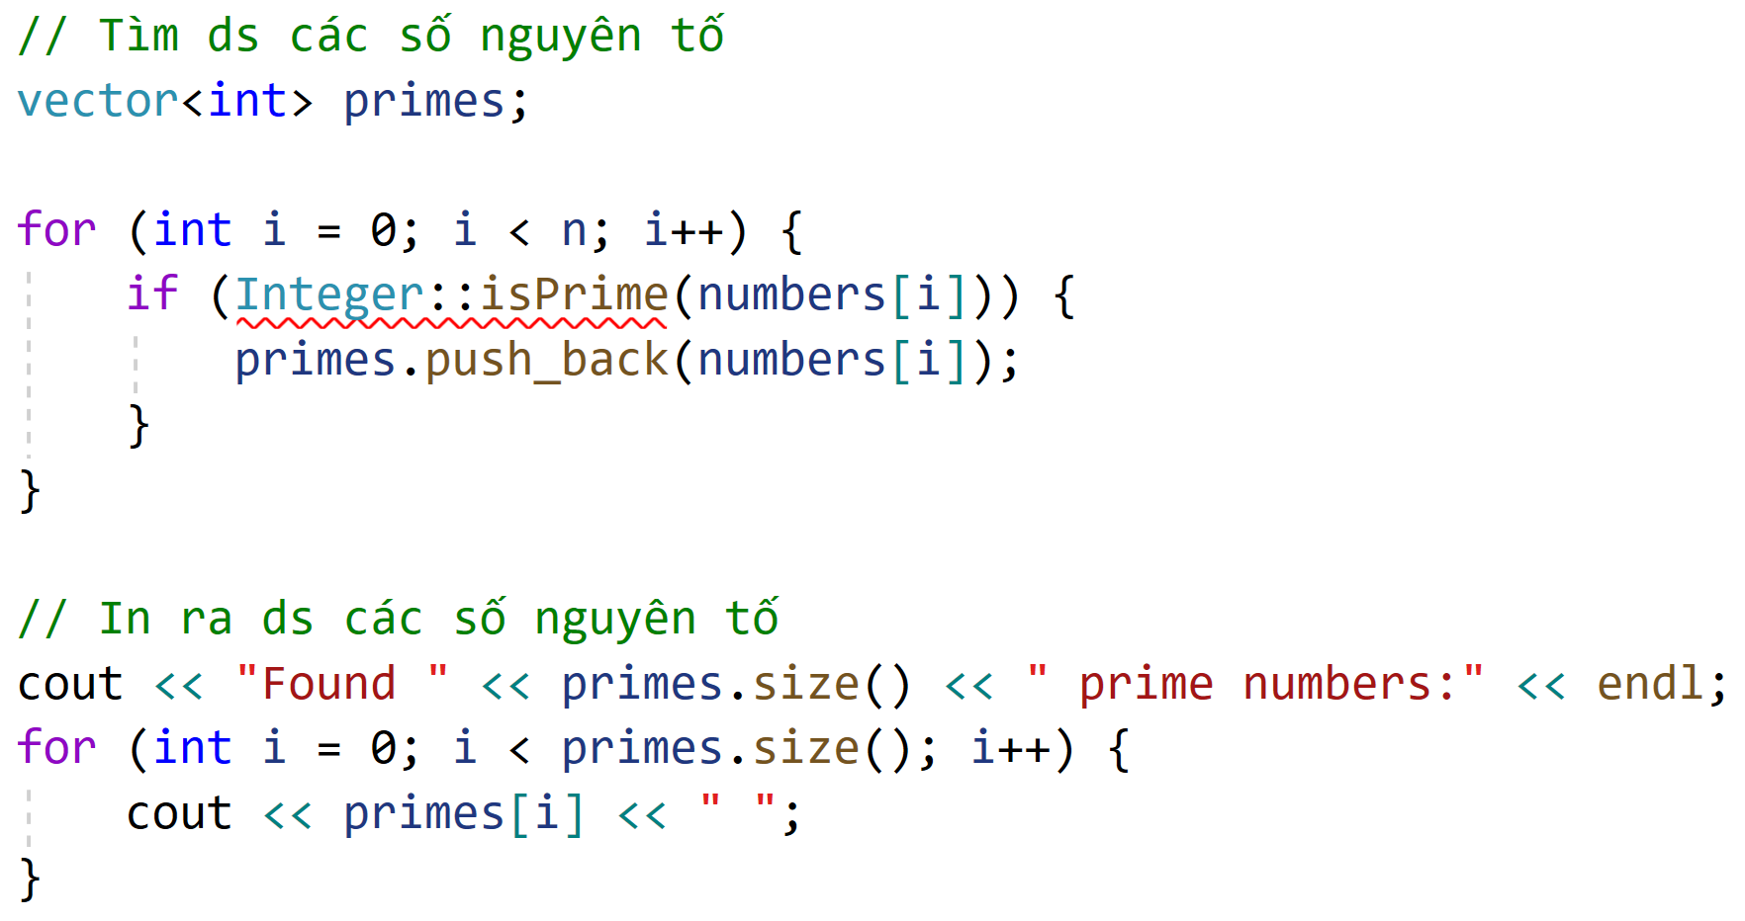
Sample

Slide 12

Further practice
Generate n random integers with no duplicate
Application: In a department which consists of 20 people. Everybody will take turn to dump the office trash. You will want to randomly select an employee with no duplicate in 20 days. The whole process will be repeated in 20 days cycle.

Slide 13
2.Dice

Slide 14
Requirements
A dice will generate a number from 1 to 6 for each roll
Generate a random integer n (3 <= n <= 8)
Roll the dice n times and print out total points

Slide 15

Class diagram - Analysis

Slide 16
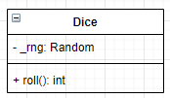
Class diagram - Design

Slide 17
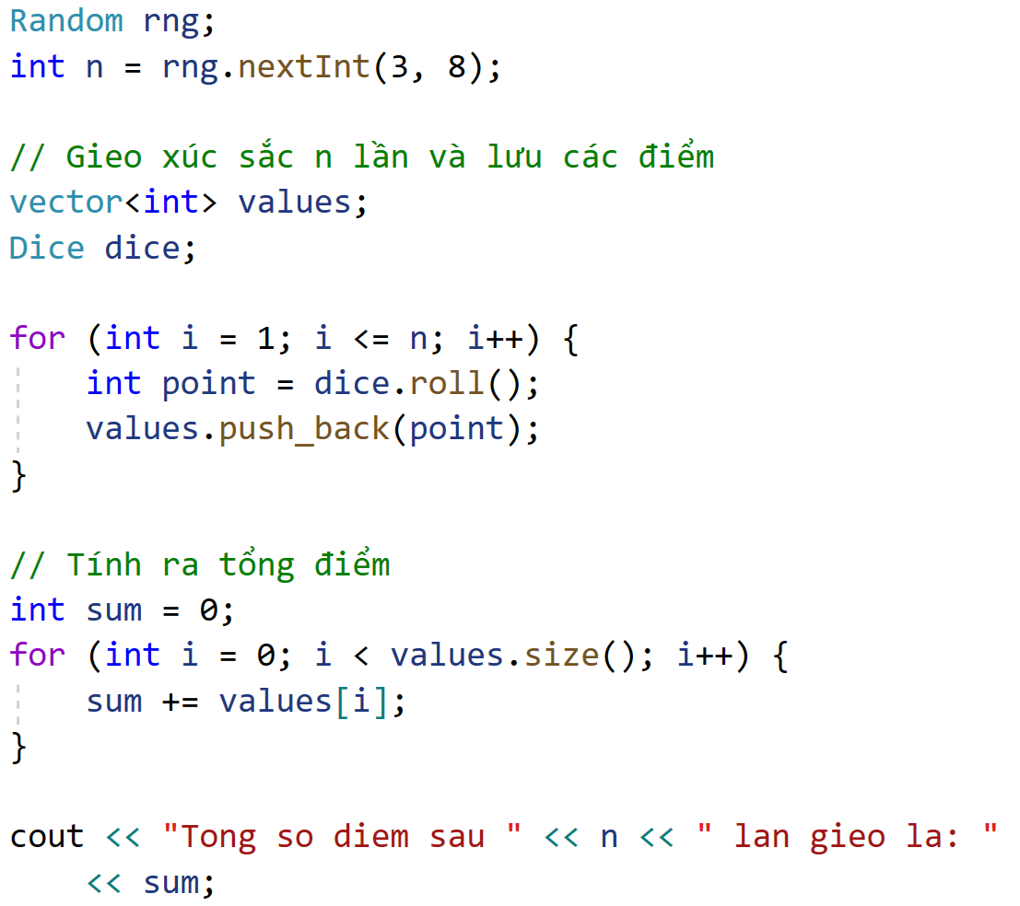
Sample

Slide 18
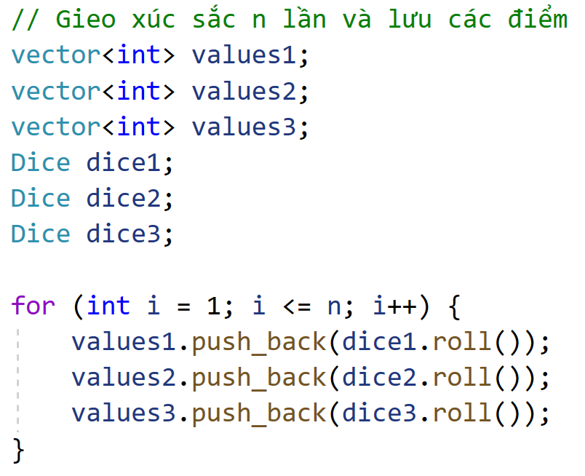
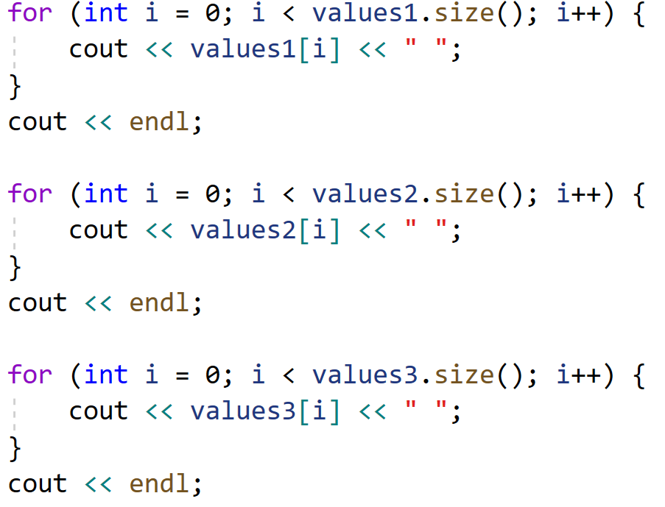
Further practice
Create 3 dice, roll n times and print out all values

Slide 19
Further improvement
The Random class is instantiated quite a lot of time
We can check that its constructor is called multiple times
All this constructor does is initializing the randomizer with a seed, every time it is called, the seed is changed
How can we do the seeding only once?
Singleton

Slide 20
3.Telephone

Slide 21
Requirements
Generate 20 random telephone numbers
Report on the number of
Operators appeared
Telephone numbers for each operator
Name the projects: P03_Telephone

Slide 22
Reference
List of all Vietnam operators
https://quantrimang.com/danh-sach-dau-so-cac-mang-di-dong-o-viet-nam-133203
(MobileNetwork("Viettel", { "086", "096", "097", "098", "032", "033", "034", "035", "036", "037", "038", "039" }));
(MobileNetwork("Vinaphone", { "088", "091", "094", "083", "084", "085", "081", "082" }));
(MobileNetwork("Mobiphone", { "089", "090", "093", "070", "079", "077", "076", "078" }));
(MobileNetwork("Vietnamobile", { "092", "056", "058" }));
(MobileNetwork("GMobile", { "099", "059" }));
(MobileNetwork("Itelecom", { "087" }));

Slide 23
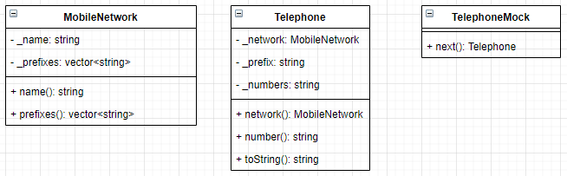
Class diagram - Analysis

Slide 24
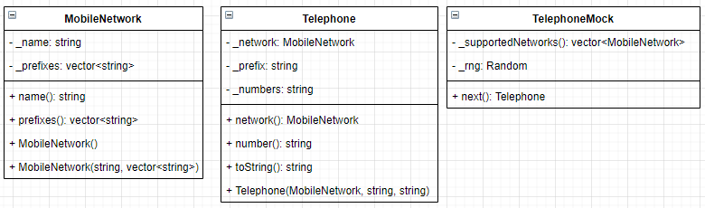
Class diagram - Design

Slide 25
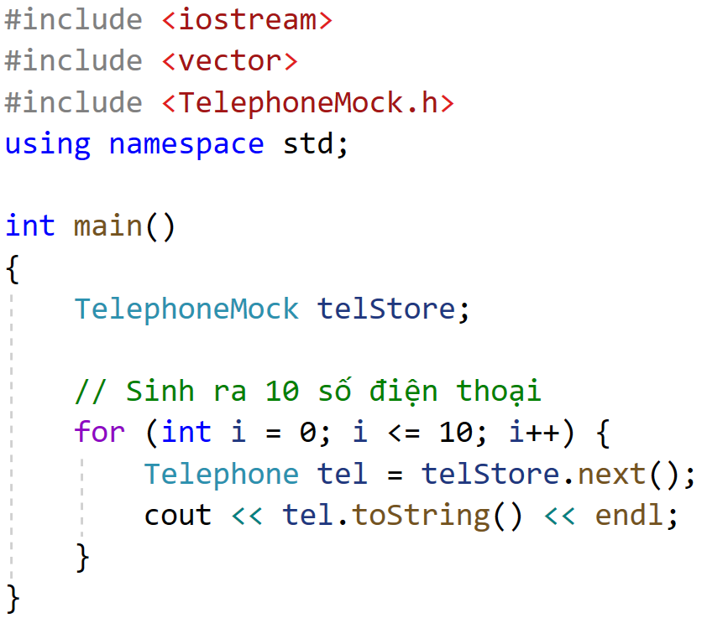
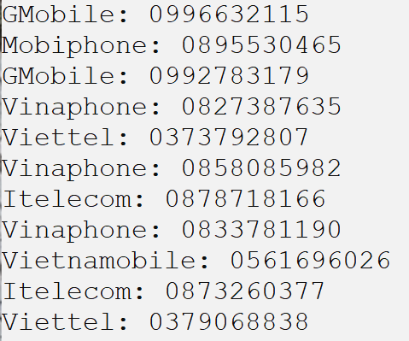
Sample

Slide 26
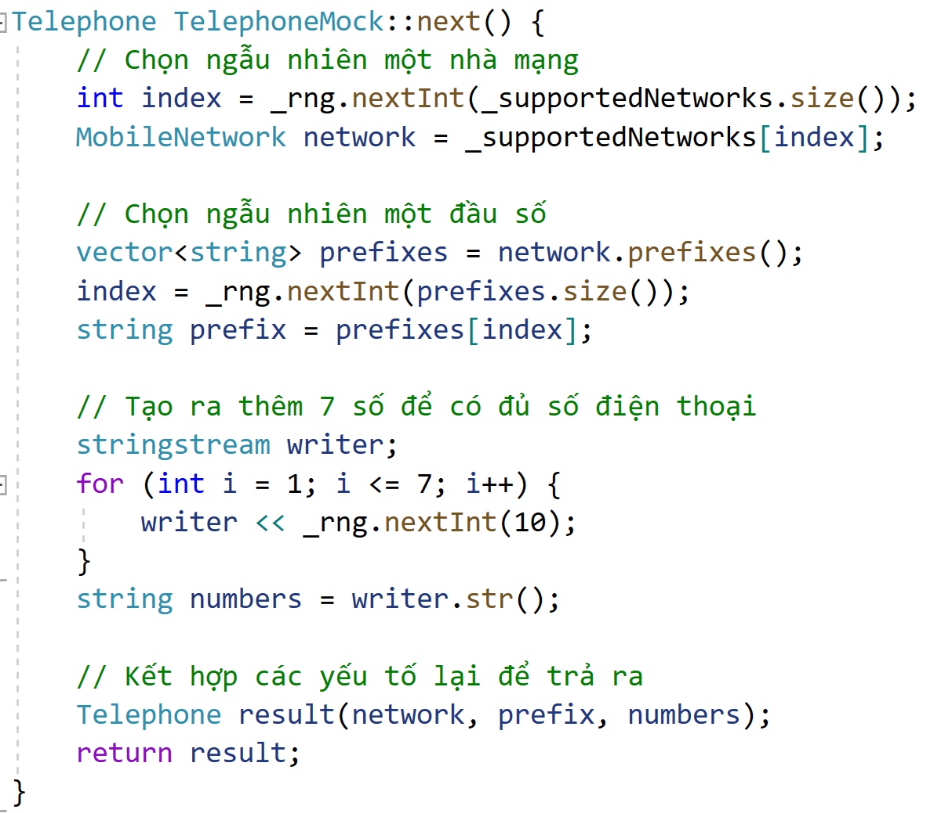
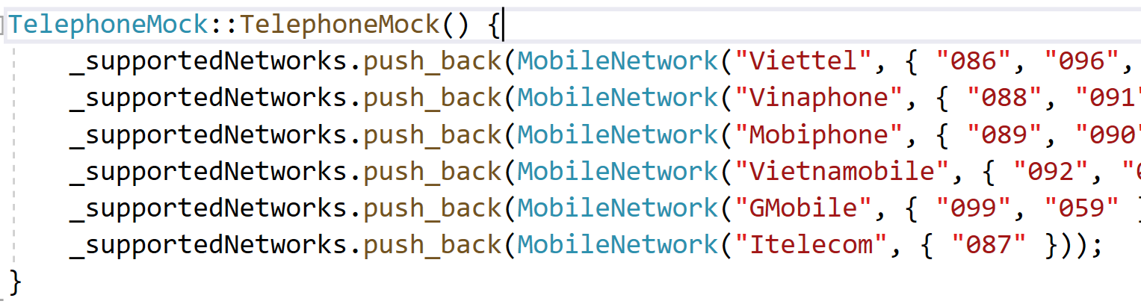
Next telephone example

Slide 27
Improvement

Slide 28
4.Fullname

Slide 29
Requirements
Generate 10 male and 10 female names
Name your project: P04_Fullname

Slide 30
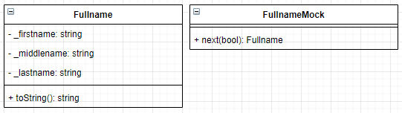
Class diagram - Analysis

Slide 31
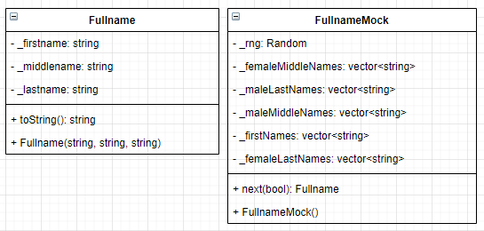
Class diagram - Design

Slide 32
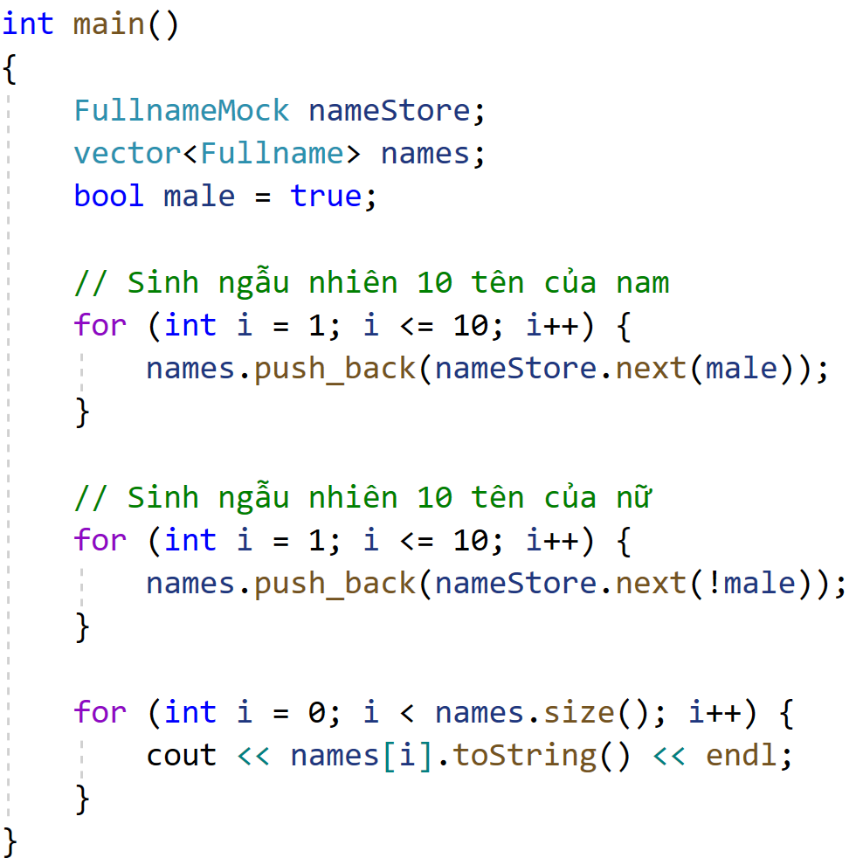
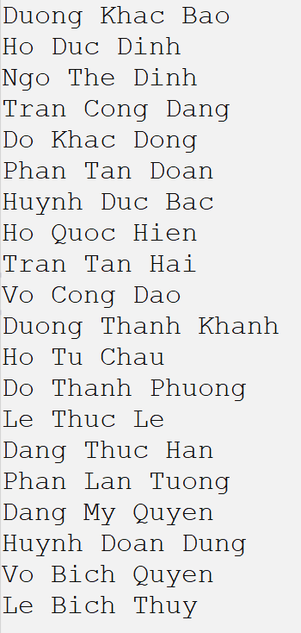
Sample code

Slide 33
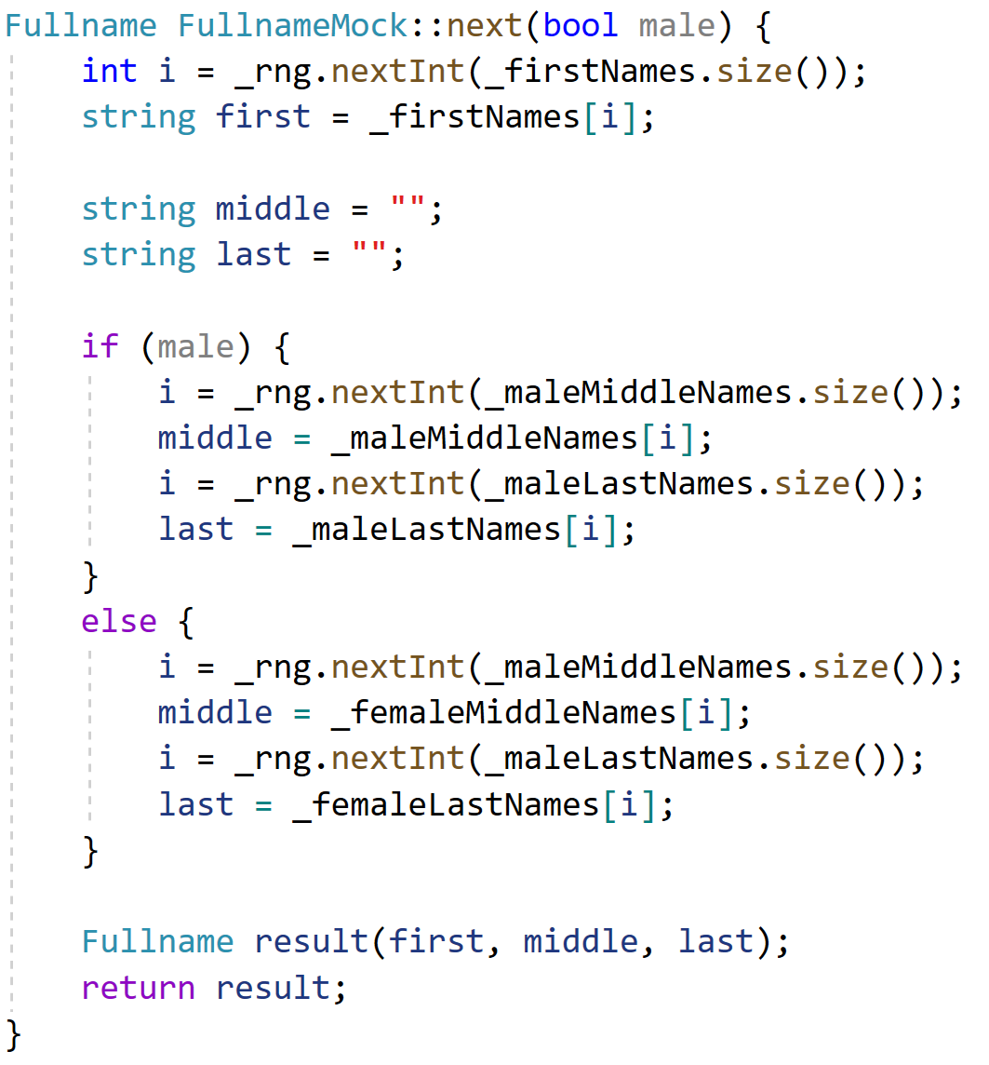
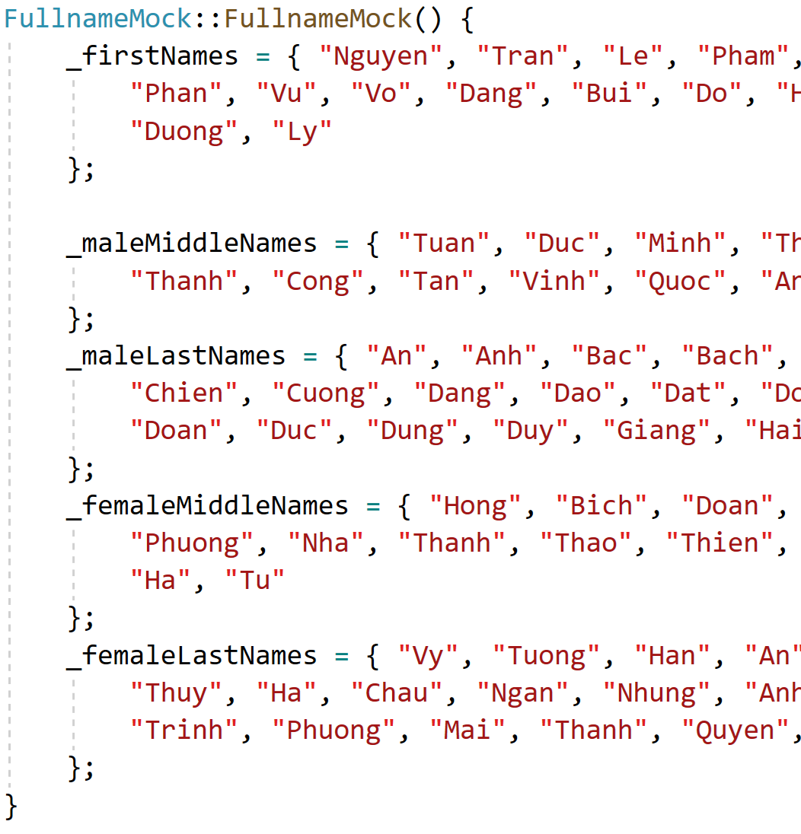
Fullname mock sample

Slide 34
Improvement
Read all the first names, middle names and last names from text file
From Unicode text file
Create certain name combinations
Ex: only Tuấn, Minh, Thanh, Thế can go with An
Ex: only Đức, Duy, Thế, Hữu, Hoàng can go with Bảo
Generate with probability distribution
https://vi.wikipedia.org/wiki/H%E1%BB%8D_ng%C6%B0%E1%BB%9Di_Vi%E1%BB%87t_Nam

Slide 35
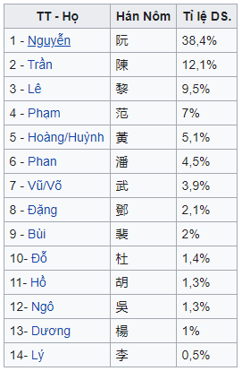
First name distribution

Slide 36
5.Email

Slide 37
Requirements
Generate a random integer n ( 10 <= n <= 100)
Generate n random integers, each number in the range of (1, 100)
Find and print out all prime numbers
Calculate the average value of all prime numbers
Find the minimum and maximum prime number
Name the project: P01_RandomIntegers

Slide 38
Requirements
Generate 20 email from at least 5 domain
Name your project: P05_Email

Slide 39

Class diagram - Analysis

Slide 40
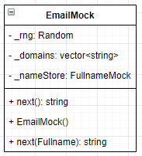
Class diagram - Design

Slide 41
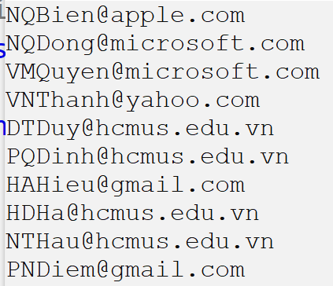
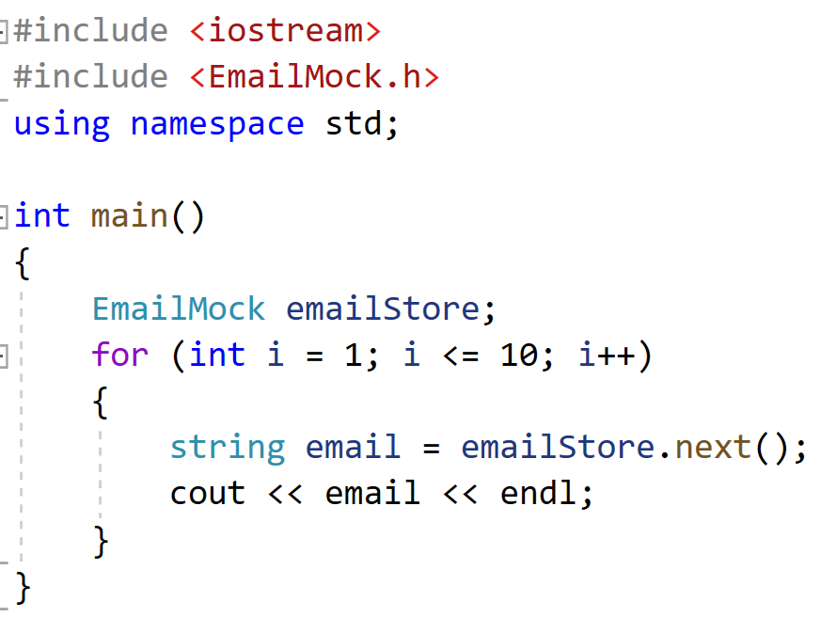
Sample source code

Slide 42
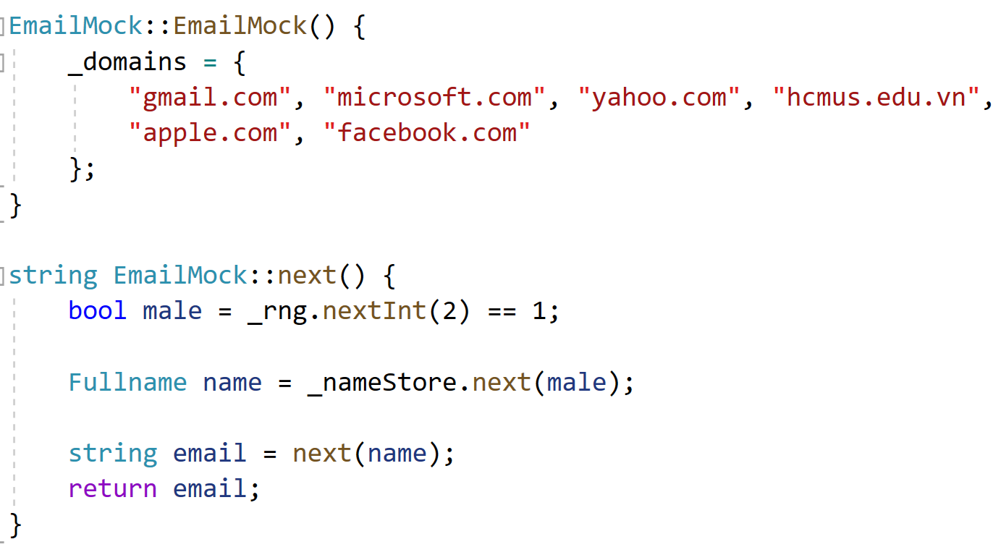
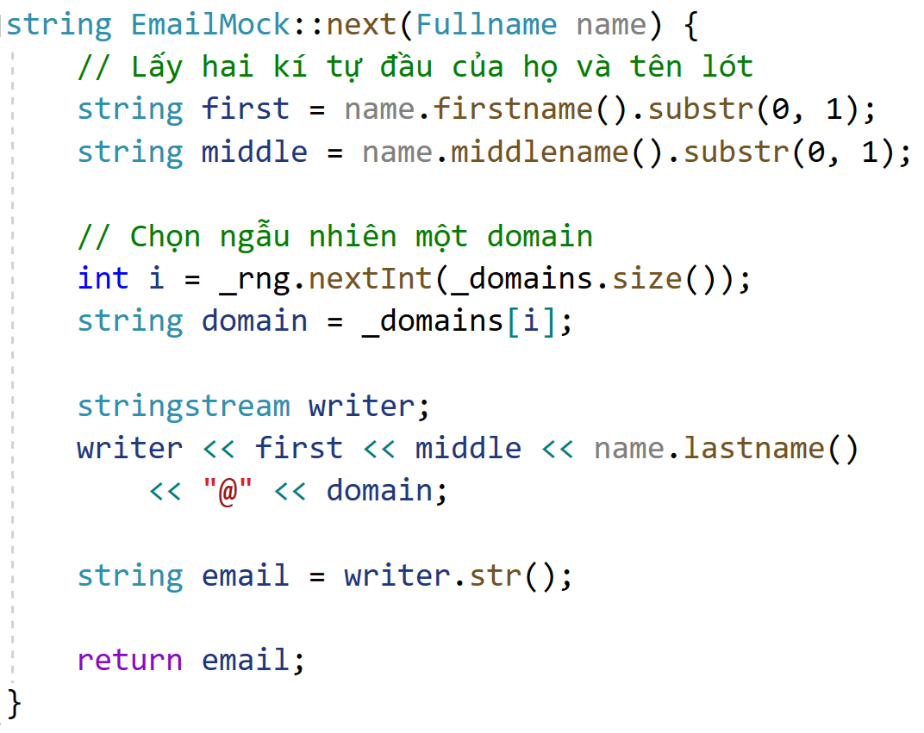
Sample mock generator code

Slide 43
Improvement
Support at least 20 domains
Read from text file
Return email with all lowercased

Slide 44
6.HcmAddress

Slide 45
Requirements
Generate random 10 address in HCM
A mock address should have a house number, street name, ward, district, city name
At the moment, just keep it that simple, forget about multiple slashes (Ex: 77/22/12/12/3) or Thu Duc city

Slide 46
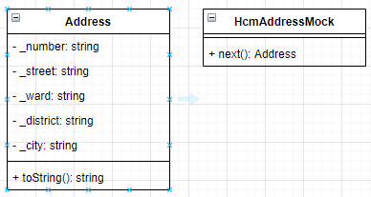
Class diagram - Analysis

Slide 47
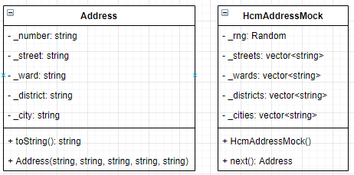
Class diagram - Design

Slide 48
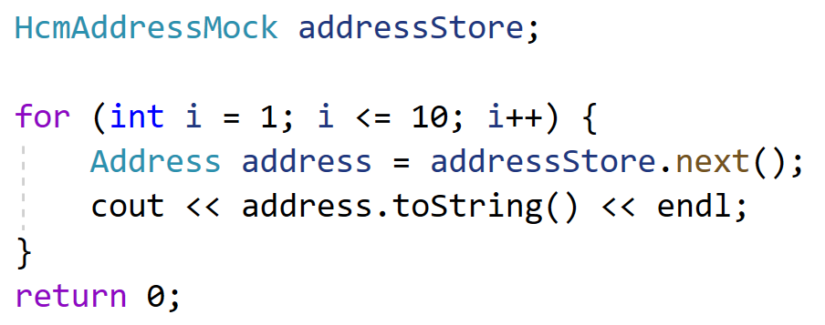
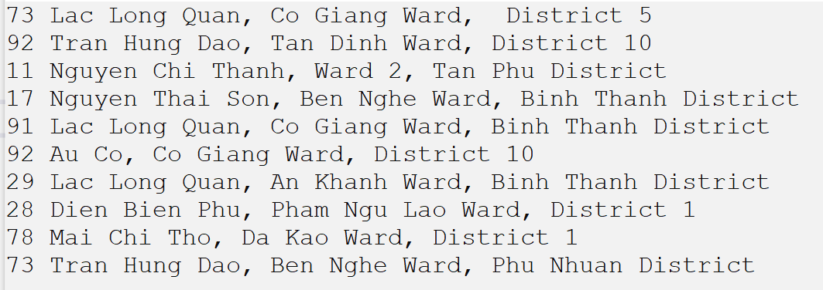
Sample source code

Slide 49
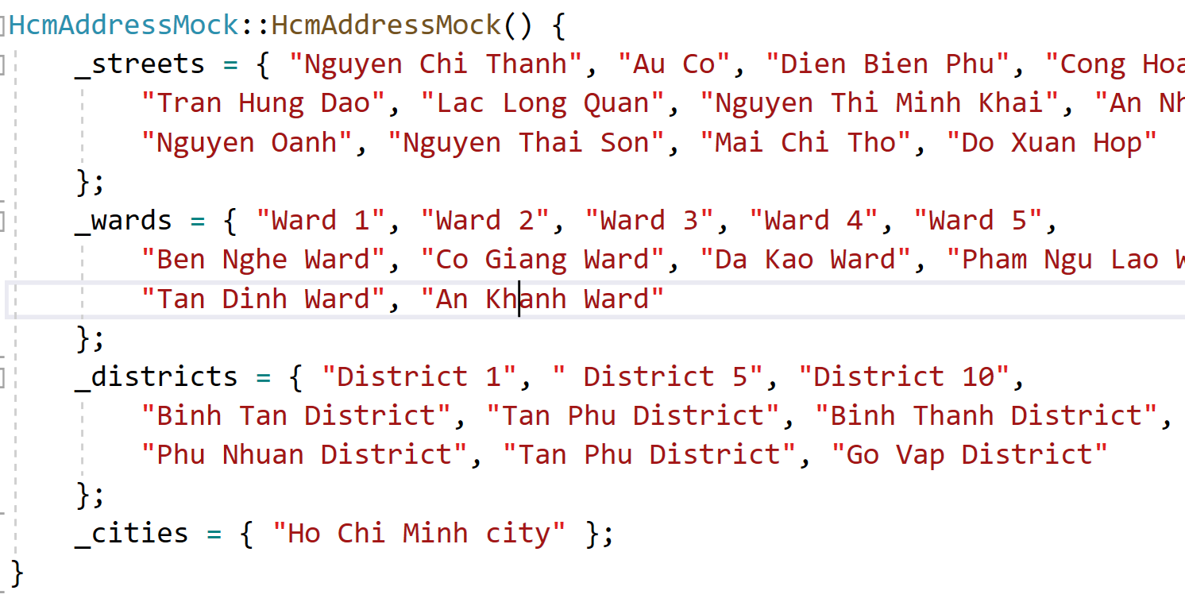
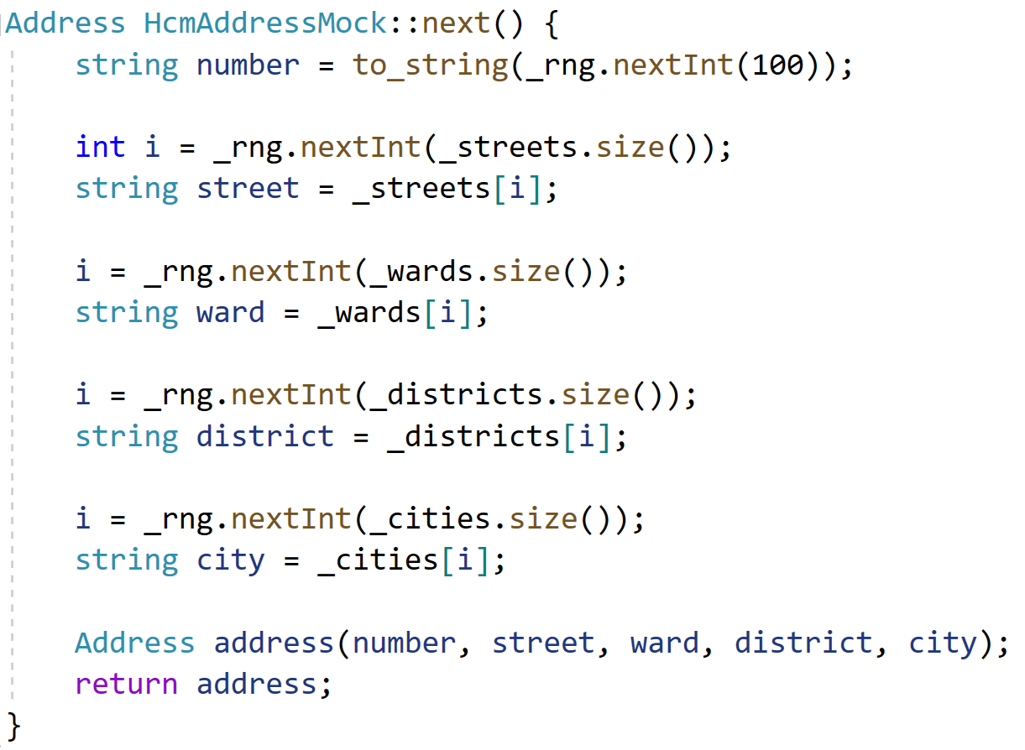
Address generator code

Slide 50
Improvement
Use real street names and wards from a district
Read all data from text file

Slide 51
7.Birthday

Slide 52
Requirements
Generate 10 birthdays
Name your project: P08_Birthday

Slide 53
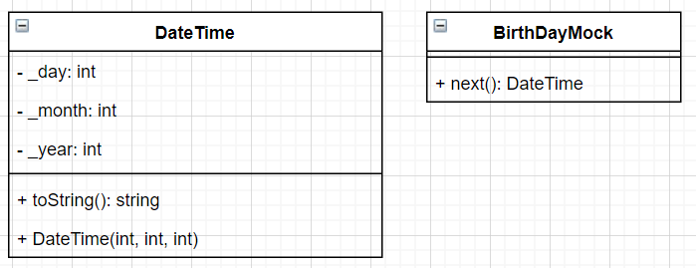
Class diagram - Analysis

Slide 54
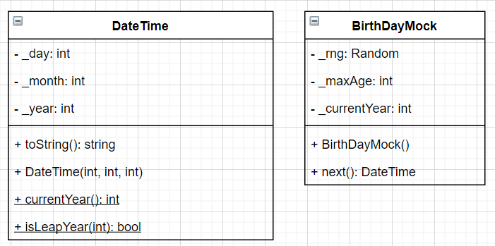
Class diagram - Design

Slide 55
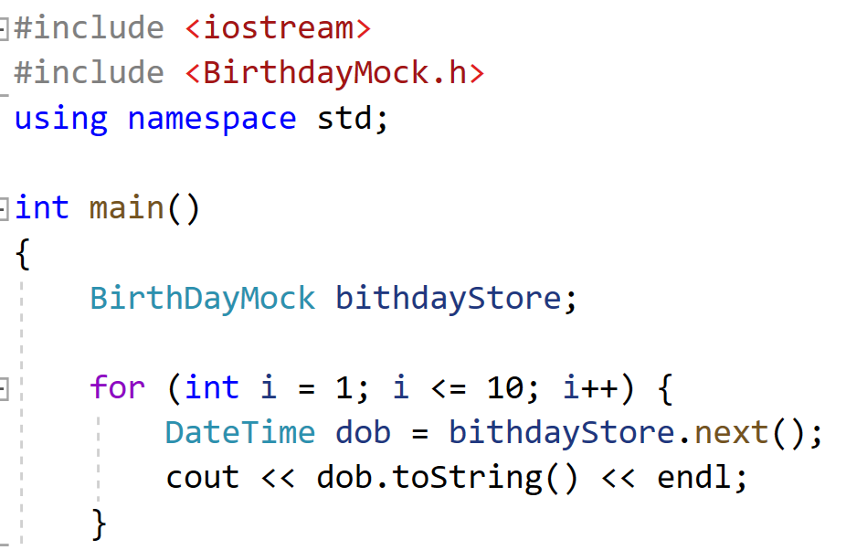
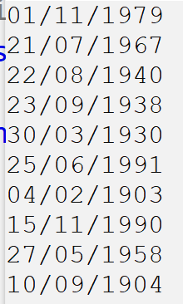
Sample code

Slide 56
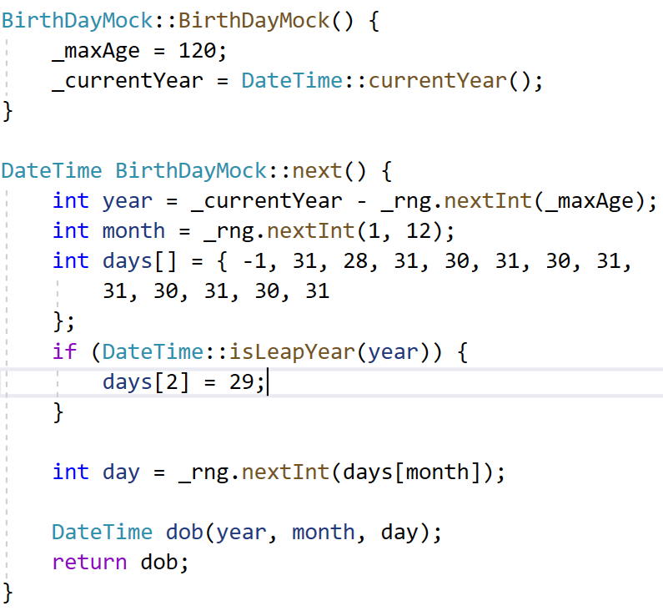
Sample generation code

Slide 57
8.CitizenId

Slide 58
Requirements
Generate 10 random citizen ids
Name your projects: P08_CitizenId
https://luatminhkhue.vn/y-nghia-12-so-the-can-cuoc-cong-dan-la-gi--the-can-cuoc-cong-dan-nhu-the-nao-.aspx

Slide 59
Information
First 3: Born city code
4th: Century code + gender
5&6th: Last 2 digits of birth year
Last 6 digits: random from 000 001 to 999 999

Slide 60
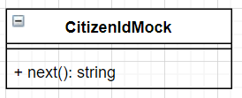
Class diagram - analysis

Slide 61
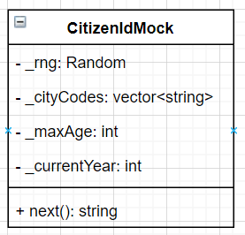
Class analysis - Design

Slide 62
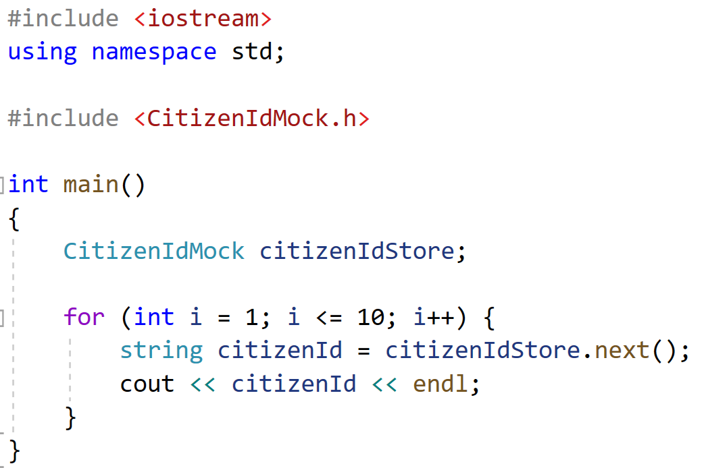
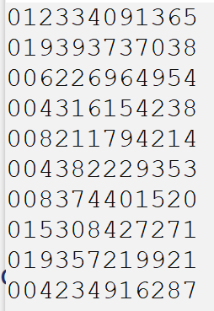
Sample code

Slide 63
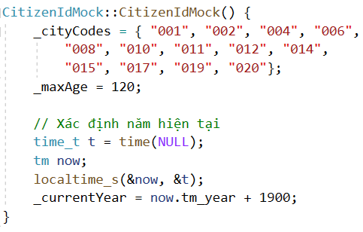
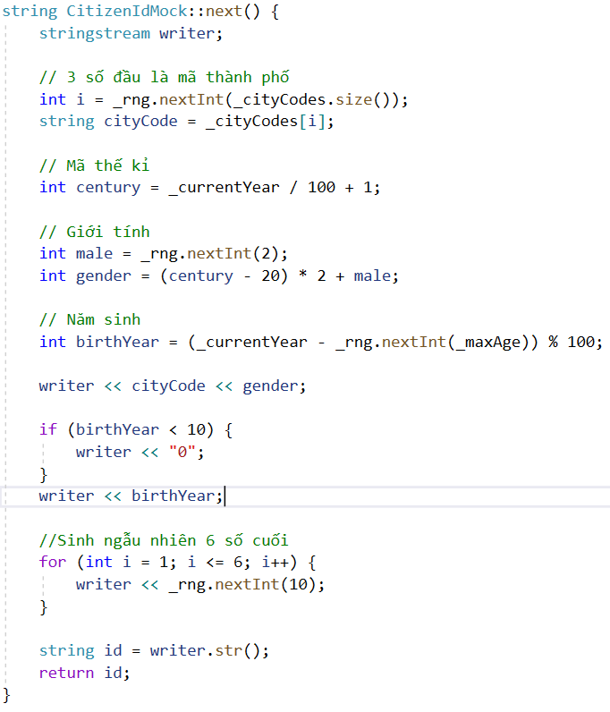
Sample generator code

Slide 64
Improvement
Read all city codes from text file
Create lookup function for city code, answer the city name

Slide 65
9.Student

Slide 66
Requirements
Generate a random integer n ( 5 <= n <= 20)
Generate random n students, each with the following information: StudentID, StudentName, CitizenId, Telephone, Email, HcmAddress, Birthday
Save all n students in students.txt output text file
Find all students that have birthday on February
Find all students that have Viettel number
Find all students that use gmail
Find all students that live in District 1

Slide 67
Class diagram - Analysis

Slide 68
Class diagram - Design

Slide 69
Question?

